Slide 1
Python Basics
June 9th, 2019
本週進度:
從零開始學Python (Chapter 3.1/3.2/3.3)
Python 3.x程式語言特訓教材 (Chapter 2/3)

Slide 2
選擇敘述

Slide 3
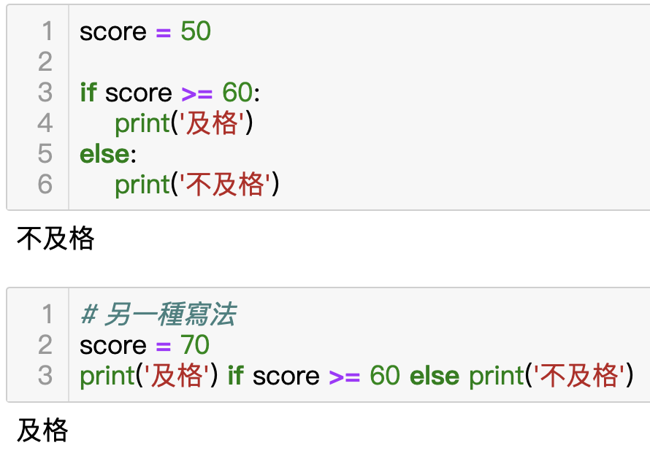
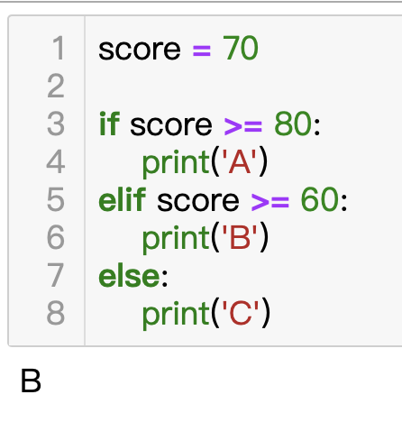
if / if-else / if-elif-else (Chapter 3.2)
範例說明

Slide 4
ITSA 01
https://e-tutor.itsa.org.tw/e-Tutor/mod/programming/view.php?id=18645
課堂練習
[Problem 1] 判斷 3 整數是否能構成三角形之三邊長
問題描述： 試撰寫一程式，判斷這三個整數是否能構成三角形的三個邊長
（註 : 三角形兩邊長之和必須大於第三邊）。
輸入說明：
輸入為一行字串，包含了三個數值，每個數值以空白隔開。
三個數值分別為三角形的三個邊長。
輸出說明：
輸出符合 (fit) 或不符合 (unfit) 。
範例：
Sample Input: | Sample Output:
1, 2, 3 4, 5, 6 | unfit fit
(1) side1 = int(input(“請輸入第一個邊長: “))
side2 = int(input(“請輸入第二個邊長: “))
side3 = int(input(“請輸入第三個邊長: “))
(2) side1, side2, side3 = eval(input(“輸入三個邊長, 以逗號分隔: “))

Slide 5
ITSA 02
https://e-tutor.itsa.org.tw/e-Tutor/mod/programming/view.php?id=11696
課堂練習
[Problem 3] 判斷座標是否在圓形的範圍內
問題描述：
有一圓形，直徑為 200 ，且中心座標為 (0,0) 。請寫一支程式可以輸入「點」的座標，並判斷「點」是否在圓形的範圍內。如果「點」的位置剛好在邊界的話也算是在圓形範圍內 ( 例： x =100 ， y =0) 。
輸入說明：
輸入一整數座標，依序分別 x 與 y ，以一個逗號隔開。
輸出說明：
輸出此座標位置在圓內 ( inside ) 或圓外 ( outside ) 訊息。
範例：
Sample Input: | Sample Output:
50,50 | inside
200,200 | outside
x, y = eval(input(“輸入一整數座標，依序分別 x 與 y ，以一個逗號隔開: “))

Slide 6
LeetCode 292. Nim Game
https://leetcode.com/problems/nim-game/
課後練習
You are playing the following Nim Game with your friend: There is a heap of stones on the table, each time one of you take turns to remove 1 to 3 stones. The one who removes the last stone will be the winner. You will take the first turn to remove the stones.
Both of you are very clever and have optimal strategies for the game. Write a function to determine whether you can win the game given the number of stones in the heap.
Example:
Input: 4
Output: false
Explanation: If there are 4 stones in the heap, then you will never win the game; No matter 1, 2, or 3 stones you remove, the last stone will always be removed by your friend.

Slide 7
迴圈敘述

Slide 8
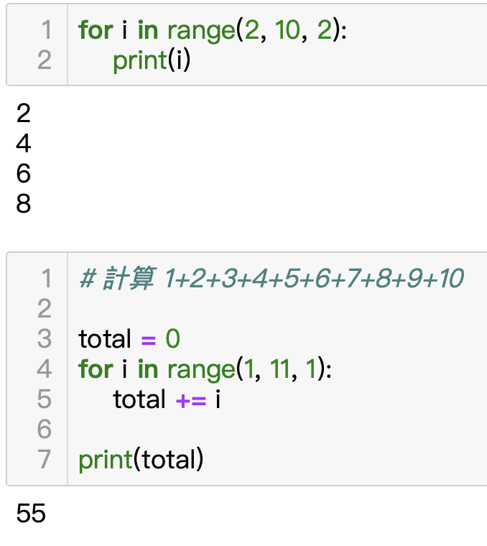
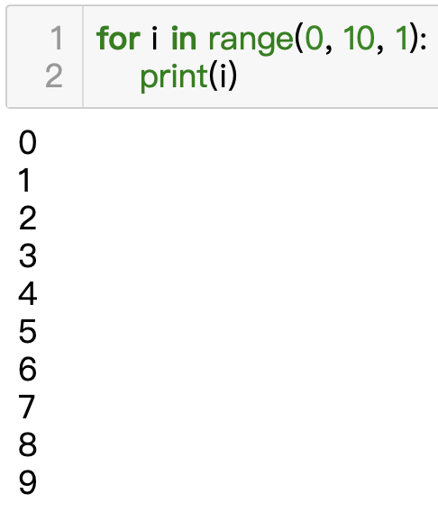
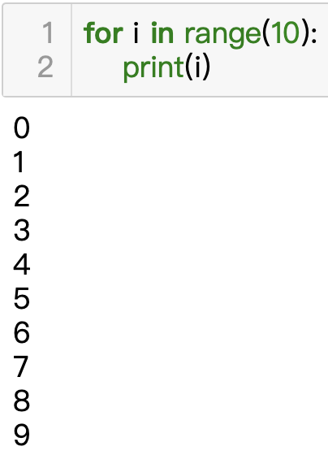
for-loop (Chapter 3.3.1)
範例說明
range(stop)
range(start, stop[, step])

Slide 9
ITSA 03
https://e-tutor.itsa.org.tw/e-Tutor/mod/programming/view.php?id=11713
課堂練習
[Problem 1] 計算寶石價值
問題描述：
筱雯是一個珠寶商，為了要讓客人知道幾克拉的鑽石大約是多大，所以打算展示一連續大小的鑽石，而鑽石的價值是根據它的重量的平方來計算的，如 5 克拉鑽石的價值是 25 萬，若打算展示 3 克拉至 6 克拉的鑽石，則需要 3² + 4² + 5² + 6² = 86 萬的成本。筱雯的數學不是很好，計算機一個個數字按起來也很辛苦，而且很容易出錯。請你幫筱雯一個忙，寫一個程式讓他能夠輕易的輸入兩個整數，即能算出此二整數之間所有整數的平方和。
輸入說明：
每行測試資料有兩個整數 n 與 m ， 以一個逗號隔開。
輸出說明：
輸出 n² + (n + 1)² +...+ m² 的結果，每筆測試資料輸出於一行。
範例：
Sample Input: | Sample Output:
1,50 5,100 | 42925 338320

Slide 10
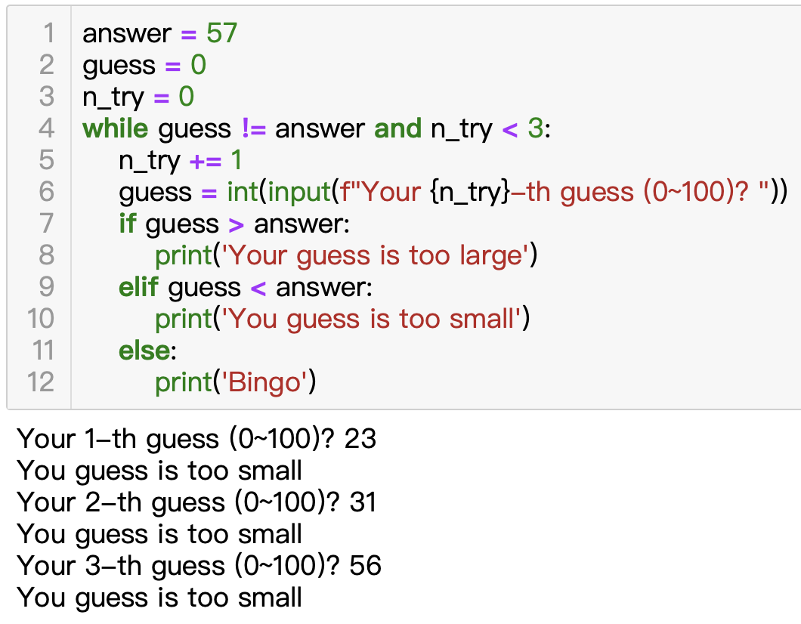
while-loop (Chapter 3.3.2)
範例說明

Slide 11
while-loop (Chapter 3.3.2)
課堂練習
72法則 [Link]
問題描述：
投資1,000,000元, 假設年化報酬率7%, 請問過了幾年之後金額會變成2倍?

Slide 12
ZeroJudge a740: 质因数之和
https://zerojudge.tw/ShowProblem?problemid=a740
課堂練習
求一个数全部质因数之和, 比如:
6 = 2 x 3，则输出 2 + 3 = 5
8 = 2 x 2 x 2，则输出 2 + 2 + 2 = 6

Slide 13
LeetCode 374. Guess Number Higher or Lower
https://leetcode.com/problems/guess-number-higher-or-lower/
課後練習
We are playing the Guess Game. The game is as follows:
I pick a number from 1 to n (inclusive). You have to guess which number I picked.
Every time you guess wrong, I'll tell you whether the number is higher or lower.
lower
higher
Congrats! You got it!
Example :
Input: n = 10, pick = 6
Output: 6
import random
pick = random.randint(1, n)

Slide 14
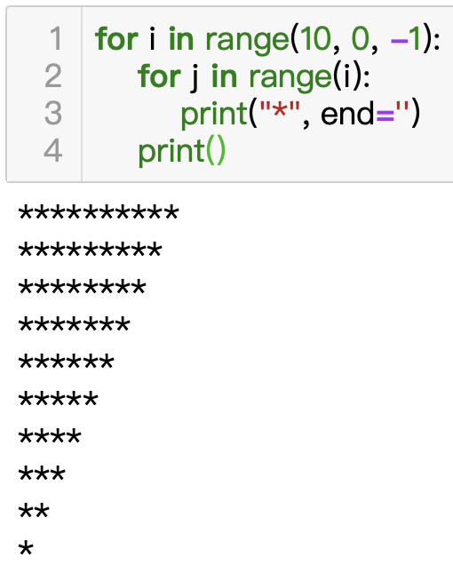
Nested for-loop (Chapter 3.3.3)
範例說明
print out the pattern in the figure below

Slide 15
Nested for-loop (Chapter 3.3.3)
課堂練習
print out 99 multiplication table
2 x 2 = 4 2 x 3 = 6 2 x 4 = 8 2 x 5 = 10 2 x 6 = 12 2 x 7 = 14 2 x 8 = 16 2 x 9 = 18
3 x 2 = 6 3 x 3 = 9 3 x 4 = 12 3 x 5 = 15 3 x 6 = 18 3 x 7 = 21 3 x 8 = 24 3 x 9 = 27
4 x 2 = 8 4 x 3 = 12 4 x 4 = 16 4 x 5 = 20 4 x 6 = 24 4 x 7 = 28 4 x 8 = 32 4 x 9 = 36
5 x 2 = 10 5 x 3 = 15 5 x 4 = 20 5 x 5 = 25 5 x 6 = 30 5 x 7 = 35 5 x 8 = 40 5 x 9 = 45
6 x 2 = 12 6 x 3 = 18 6 x 4 = 24 6 x 5 = 30 6 x 6 = 36 6 x 7 = 42 6 x 8 = 48 6 x 9 = 54
7 x 2 = 14 7 x 3 = 21 7 x 4 = 28 7 x 5 = 35 7 x 6 = 42 7 x 7 = 49 7 x 8 = 56 7 x 9 = 63
8 x 2 = 16 8 x 3 = 24 8 x 4 = 32 8 x 5 = 40 8 x 6 = 48 8 x 7 = 56 8 x 8 = 64 8 x 9 = 72
9 x 2 = 18 9 x 3 = 27 9 x 4 = 36 9 x 5 = 45 9 x 6 = 54 9 x 7 = 63 9 x 8 = 72 9 x 9 = 81

